Slide 1
Lesson 1 - Day 2

Slide 2
Lesson Overview
Day 2
Stop and Think- 3 mins
Cluster student models- by type. Discuss what themes emerge in the models- 5 mins
Evidence discussion- what is evidence and why do scientists use evidence? Will lead to the idea that we need evidence to support the models 5 mins
Evidence activity- students review evidence on the handout 20 mins
Discussions- discuss what students learned from the evidence about why the fish are dying (lack of dissolved air) 5 mins
Consensus model- create a class consensus model to show why the fish are dying 10 mins
Before you go- 2 mins
Total time: 50 mins

Slide 3
STOP & THINK!
Grab a handout and put your name and information on the top of the first page.
Complete the STOP & THINK! question on the first page.
How can we figure out which model gives the best explanation for why the fish are dying?
Notes:
BEGINNING OF DAY 2
Use this “Stop & Think” as a do now.
Tell students they will be figuring out which models give the best explanation of why fish are dying in Passion Puddle. They will figure this out in this next activity.
Do not hold a class discussion at this point. Just let them do the STOP & THINK, maybe solicit one or two answers and move on. Keep this very brief.

Slide 4
Our Models
A
More sunlight in the spring
Water gets too hot for fish
Fish die
Pollution gets into water
Pollution poisons fish
B
Fish die
Something important went missing!
Fish do not have enough food or air
C
Fish die
D
Fish got sick
The sickness spread
Fish die
Notes:
Briefly review the model groups/clusters from yesterday. NOTE: This slide shows examples of the types of models that students might have come up with. Update this slide to reflect the ideas in your classroom OR use one example of a student model for each model cluster instead of this slide. Tell them that all these ideas are great, and they are all plausible
Ask– How can we figure out which model group explains what really happened in the pond?
Hopefully, kids will say something about experiments, observations, or evidence (which leads into next slide)

Slide 5

Evidence
What is evidence?
Why should we use evidence?
Why do scientists use evidence?
How does evidence help them figure out whether their ideas are good?
Notes:
Hopefully, students said something about using data/evidence/experiments/observation to figure out which model group is best
Ask– what is evidence? (Note: Scientific evidence is information that supports or counters a scientific theory or hypothesis). Get some ideas out. Do not correct ideas at this point (unless completely off base). Students may be talking about evidence in terms of crimes and forensics, steer them towards the idea of evidence in science- info we use to figure out theories/hypothesis.
Have them answer the rest of the questions as a discussion (if not going well-unsure/no ideas, have them work with a partner for a few min and then do a class sharing)
After asking what students think evidence is, ask why scientists use evidence. This gets them to think about the purpose for evidence.
Students should be encouraged to build on each other’s ideas- class discussion.

Slide 6
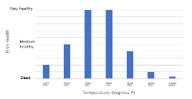
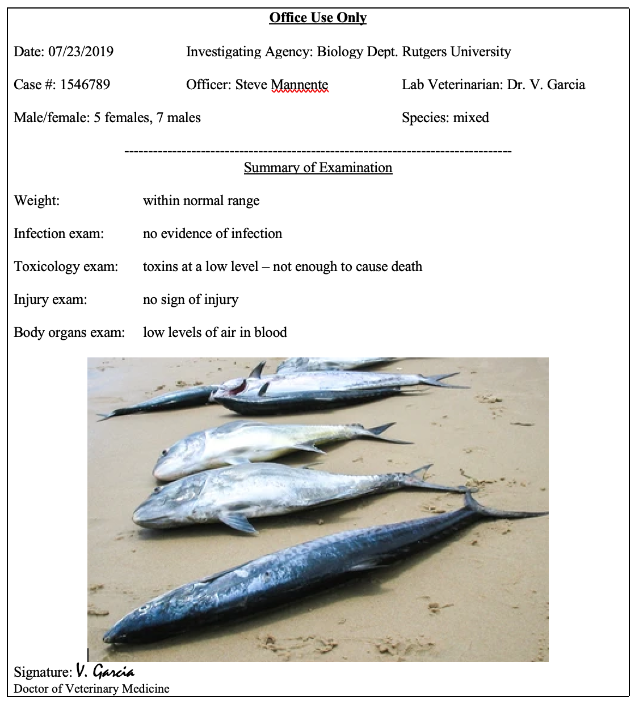
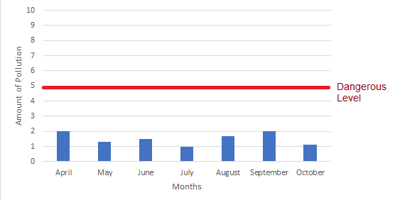
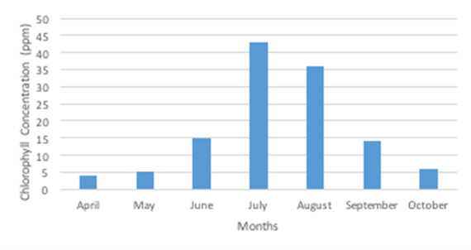
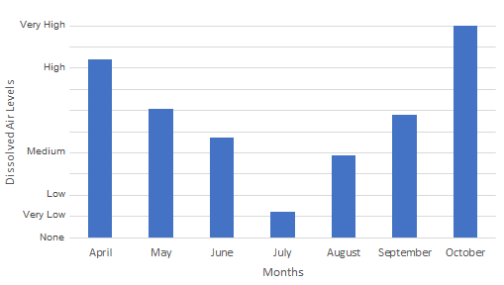
Let’s use evidence to decide which model is best.
Evidence 1
Evidence 2
Discuss ALL the evidence pieces in pairs and answer the questions individually.
Evidence 3
Evidence 4
Evidence 5
Notes:
Tell students to read the evidence in the evidence handout and think about:
What does this tell me about why the fish might be dying?
Does this support/not support the models?
If it does support one or more model, which part/s of the model does it support?
Does it contradict any of the models? Can we rule out some models?

Slide 7
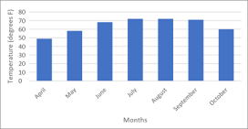
Evidence 1: Fish and Temperature
Fish Health and Temperature
Passion Puddle Average Water Temperatures (measured 1 foot below surface)
Notes:
Questions: 1. The temperature is highest in: (circle one)
April August October

Slide 8
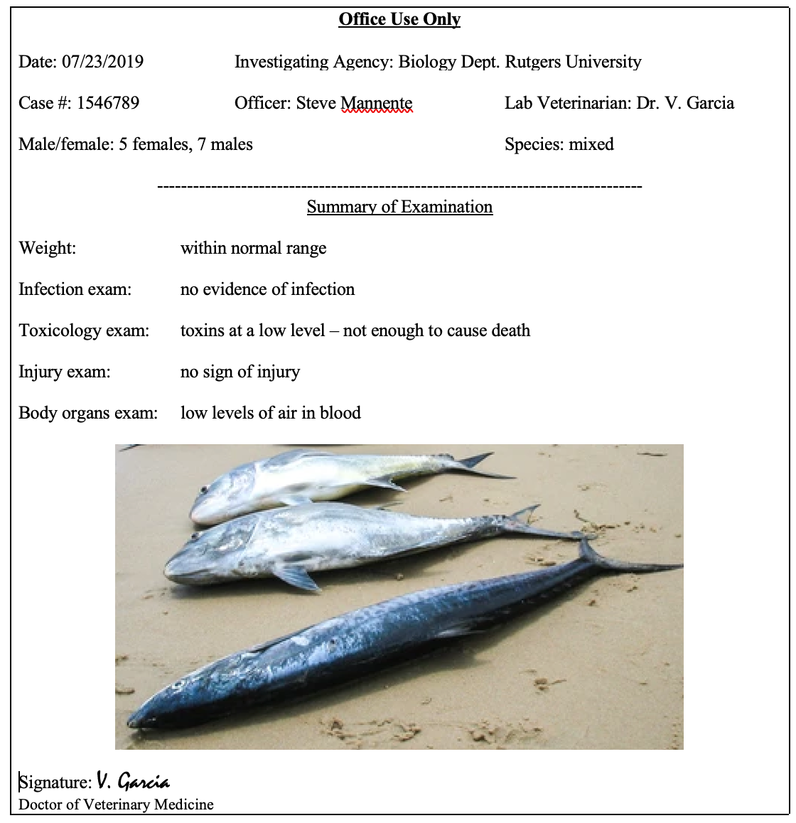
Evidence 2: Veterinary Report
Notes:
What does “low levels of air in blood” suggest about a possible cause of death?
It suggests that the fish are suffocating (they don’t need to get that right now, this is just for your reference)

Slide 9
Evidence 3: Water Quality
Passion Puddle Water Quality Data (measured 1 foot below surface)
Notes:
Based on this evidence, did the fish die from pollution? Yes No

Slide 10
Evidence 4: Pond Chlorophyll
Amount of Chlorophyll in the Pond (measured 1 foot below surface)
Notes:
Circle all of the conclusions that are correct:
Conclusion 1: There is the most algae in July
Conclusion 2: There is the most chlorophyll in July
Conclusion 3: There is the most chlorophyll in October

Slide 11
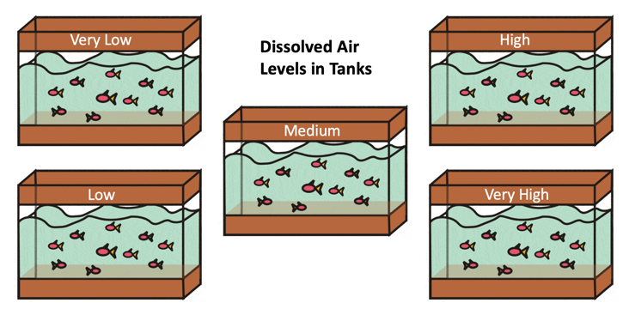
Evidence 5: Dissolved Air
Fish Air Concentration Tolerance under Laboratory Conditions
Amount of dissolved air in the tank water | Swimming speed after 5 hours
Tank 1: Very low | No swimming
Tank 2: Low | Very slow swimming
Tank 3:Medium | Slow swimming
Tank 4:High | Normal swimming
Tank 5:Very High | Normal swimming
Passion Puddle Dissolved Air in Water Concentration (measured 1 foot below surface)
Notes:
How much dissolved air do fish need to be healthy? High levels
Are there any months during the year during which the dissolved air levels are too low for fish to survive? Yes No
If you answered YES, which months?

Slide 12

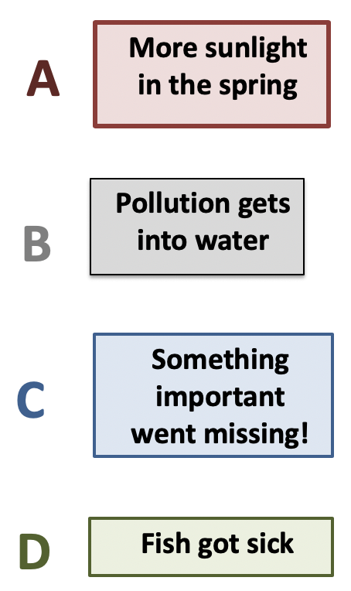
Group Discussion
What did we learn from the evidence?
Which models can we rule out?
Which model(s) is the best (most supported) explanation?
What questions do we still have?
Notes:
Discuss how the evidence shows that fish do not have enough dissolved air to survive.
Cancel out models that are no longer relevant. Reiterate how we were able to find this out by studying evidence like scientists.
Discuss any questions that students still have. Students share questions but don’t need to answer them right now. Tell students that they will be addressing many of these questions throughout the unit, and that they can add new questions when they come up.

Slide 13

Class Discussion
What did we learn from the evidence?
Which models can we rule out?
Which model(s) is the best (most supported) explanation?
What questions do we still have?
Notes:
Discuss how the evidence shows that fish do not have enough dissolved air to survive.
Cancel out models that are no longer relevant. Reiterate how we were able to find this out by studying evidence like scientists.
Discuss any questions that students still have. Students share questions but don’t need to answer them right now. Tell students that they will be addressing many of these questions throughout the unit, and that they can add new questions when they come up.

Slide 14
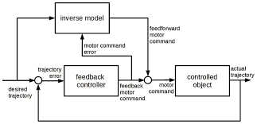
Consensus Model
As a class, let’s make a class model together, using what we’ve figured out.
Notes:
As a class, build a consensus model to show the fish are dying from lack of oxygen. Do this in the space on the slide, or on a large sticky note. Example model might be similar to the third model in slide 12 (not inserted here so the class can build it but use the example from the Pond Unit Outline as a guide).
Remind students to support their ideas with evidence, and to refer to their class criteria list.

Slide 15

BEFORE YOU GO
Grab a note and put your name and information on it.
Complete the BEFORE YOU GO questions.
Look at the class model.
On a sticky note, write down two questions you have about our explanation of why the fish died.
Stick your note on the Question Chart.
Notes:
END OF DAY 2
Use this “Before You Go” as an exit ticket.
Have the students write down two questions they have about the information in the class model. Accept all questions. Tell students that they will be addressing many of these questions throughout the unit, and that they can add new questions when they come up.
Do not hold a class discussion at this point,

